Slide 1
Is Technology Making Us Less Social???
Stefen Rice
Cas100
Penn State, Hazleton
Smr5419@psu.edu

Slide 2
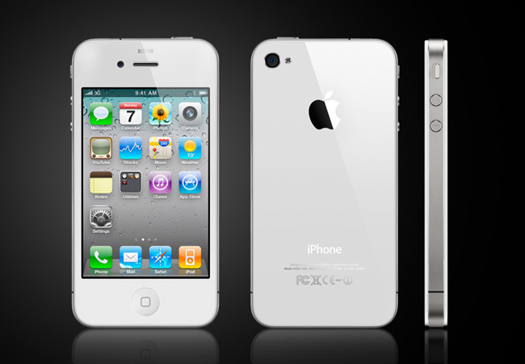
“google images”

Slide 3
The world is shifting to 140 character status updates

Slide 4
Overview
The direction of technology in the world
Technology affecting peoples social skills
Negative effects

Slide 5
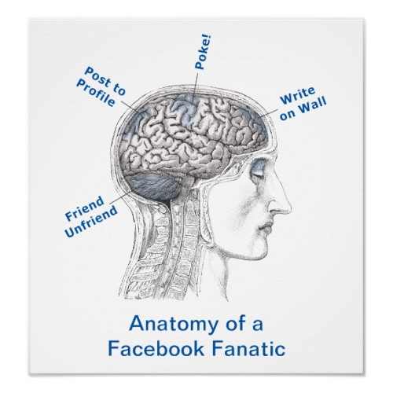
Direction of Technology
“The way in which people frantically communicate online via social network sites such as twitter can be seen as a modern form of madness” (Turkle).
“google images”

Slide 6
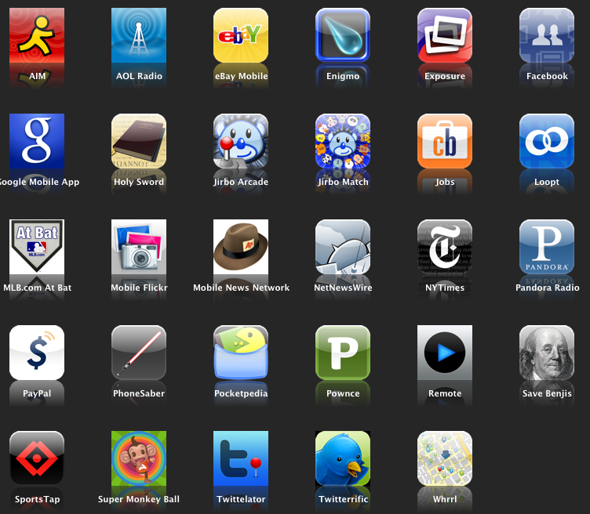
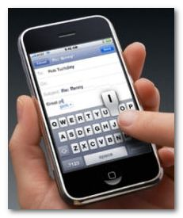
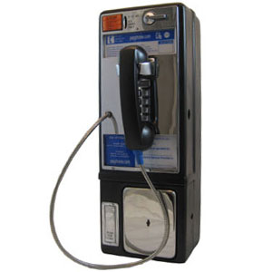
We live in a society where instant satisfaction is necessary
Texting has become the number one form of communication (CTIA)
Payphones are almost extinct
iPhones are basically computers on the go
There is an App for just about everything
“google images”

Slide 7
Are Social Skills Being Affected?
The internet has brought the world together yet is creating a wider gap of social interaction like never before. Social networking is making us less social in the sense of personable interaction with the growing number of networks and ways to stay “connected.” What is getting lost is the true purpose of communication with others.” (Social Networks)

Slide 8
Text short cuts are becoming a new language, often times mistakenly used in academic papers
Everyone knows that person in school who is more interested in their phone rather than making friends or class
According to NPR, High School reunion attendance is dropping because of Facebook and other social networks
According to CTIA 75 billion text were sent in the United States in June, 2008

Slide 9
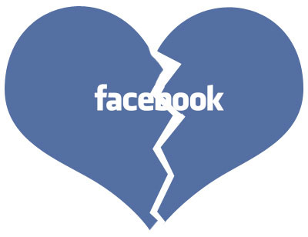
Negative Effects
People, mostly teens are resulting to difficult discussion to means of text rather then face to face speaking
Lack of communication skills due to technology result in empathy and sensitivity
Many people are beginning to break up with their girlfriend/boyfriends through text
(Albert)
“Google images”

Slide 10
Conclusion
The direction of technology in the world
Technology affecting peoples social skills
Negative effects

Slide 11
Cited Sources
Shane, Albert. “Are Teens Today Lacking in Interpersonal and Communication Skills?” May 2, 2008. Web. 6 Nov. 2011.http://www.socialdesire.com/2008/05/02/are-teens-today- lacking-in-interpersonal-and-communicative-skills/
Cesar, Marquez. “Negative aspects of texting” Boarderzine. 21 Oct. 2009. Web 7 Nov 11.http://borderzine.com/2009/10/negative-aspects-of- text-messaging/
Chaney, Suzane. “Social Networking Sites Making us less Human” MSNBC.com 29 Jan. 2011. web 6 Nov. 2011 http://technolog.msnbc.msn.com/_news/2011/01/24/5908154- social-networking-sites-making-us-less-hum
Images – “Google Images”

Slide 12
SMR5419@psu.edu

