Slide 1
What is Stress?
Stefen Rice
Cas100
Penn State Hazleton
October 10, 2011

Slide 2
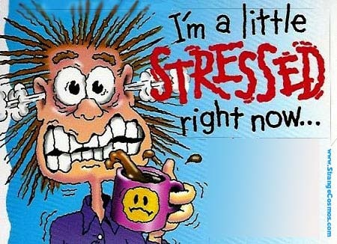
Everyone has felt this way at one time or another
“Google images”

Slide 3
Overview
What is stress
Causes of stress
Ways to manage stress

Slide 4
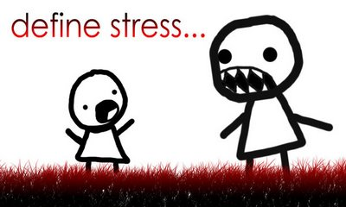

Slide 5
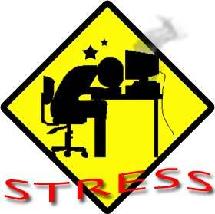
What is stress?
The term “stressed” was coined by Hans Selye in 1936.
He defined it as the non specific response of the body to any demand of change. (AIS)

Slide 6
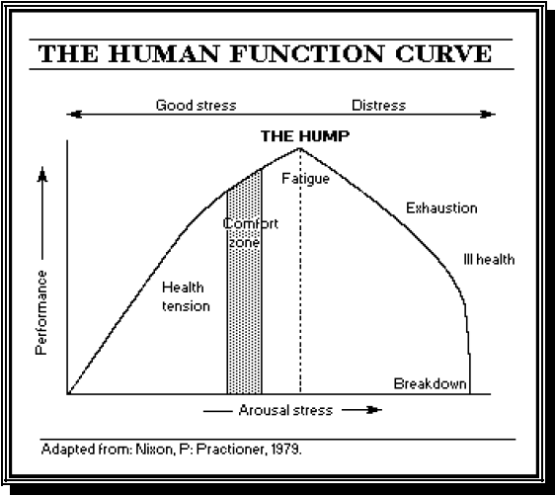
(google Images)

Slide 7
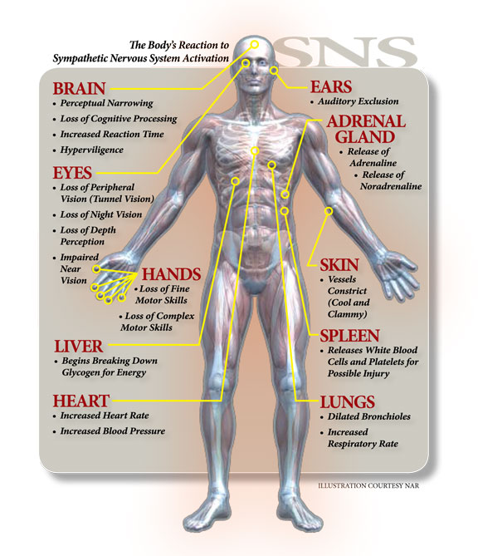
Stress biologically
When you perceive a threat your nervous system responds by releasing a flood of stress hormones including adrenaline and cortisol (AIS)
(google images)

Slide 8
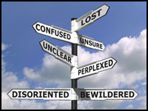
What are the causes of stress?
Major life changes
Work
Expectations
Work Load
Relationship difficulties
Pressure to do well
Social acceptance
Being away from home
(google images)

Slide 9
Stress isn’t all bad

Slide 10
Good stress
Good stress is called “Eustress” (AIS)
Hormonal levels rise causing an increase in your strength, stamina, speed, your senses become sharper and your focus enhances.
Example: Slamming on the brakes to avoid an accident.

Slide 11
(google images)

Slide 12
Ways to manage stress
Support network
Control
Attitude
Ability to deal with emotions
Knowledge
Sleep
Exercise
Eat well
(Segal, PHD)

Slide 13
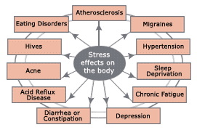
Effects of stress if not managed
Body aches
Heart Disease
Sleep Problems
Depression
Obesity
Segal, PHD
(google images)

Slide 14
Conclusion
What is stress
Causes of stress
Ways to manage stress

Slide 15
References
American Institute of Stress. Stress Definition of stress, stressor, what is stress. American Institute of stress. 1979. Web. 4 Oct. 2011. www.stress.org/topic_definition-stress.htm
Segal, Jeanne Phd. Understanding stress. Signs, symptoms, causes and effects. Sept 2011. web. Oct 4. 2011. www.helpquide.org/metal/stress_signs.htm
Pictures taken from, “Google Images”

Slide 16
Any questions?
SMR5419@psu.edu

